Slide 1
Generalized Autocalibrating Partially Parallel Acquisitions (GRAPPA)
Lee Jaeeun
2018/01/09

Slide 2
Index
Introduction
Theory
AUTO-SMASH
Algorithm
Problems
GRAPPA
Overall process
Image Reconstruction
Features
Result
Discussion
Conclusion

Slide 3
Introduction
What is the GRAPPA?
New PPA method
Get the info from k-space (no need of accurate RF maps)
Extension of PILS & VD-AUTO-SMASH
The feature of GRAPPA
Steps of image reconstruction and combination are decoupled
Higher SNR and better quality of image than preceding PPA research

Slide 4
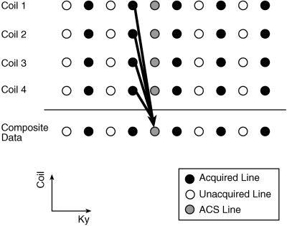

AUTO-SMASH
1 2 3 4 5 6 7 8 9 10
Algorithm
L=4
ky = 4
m = -1
del(ky) = 1
L : total # of coils
n(l,m) : weight

Slide 5
AUTO-SMASH
Problem
Low SNR
Severe phase cancellation

Slide 6
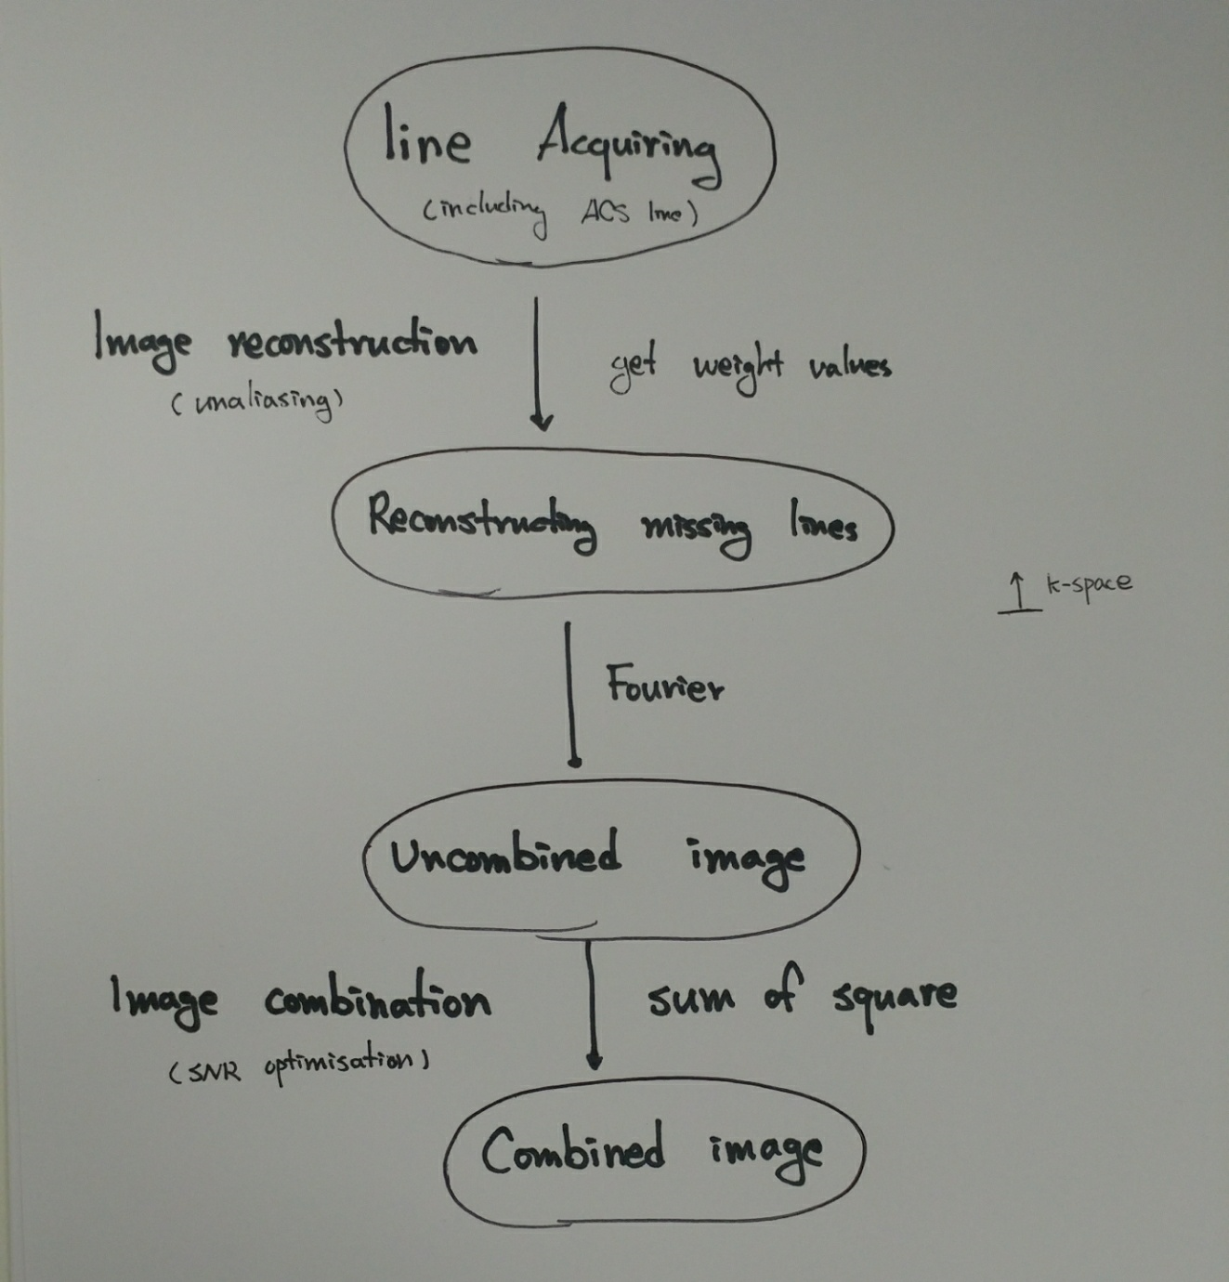
GRAPPA
- Overall process

Slide 7
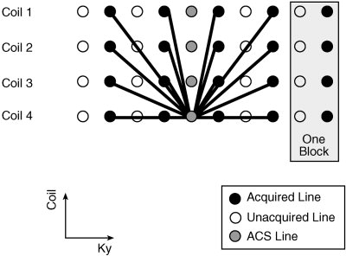

GRAPPA
- Image reconstruction
1 2 3 4 5 6 7 8 9 10
j = 4
L=4
ky = 8
m = 3
del(ky) = 1
Nb = 4
A = 2
j : ACS line get weighted
L : total # of coils
Nb : # of blocks used in reconstruction
n(j,b,l,m) : weight
A : Acceleration factor

Slide 8
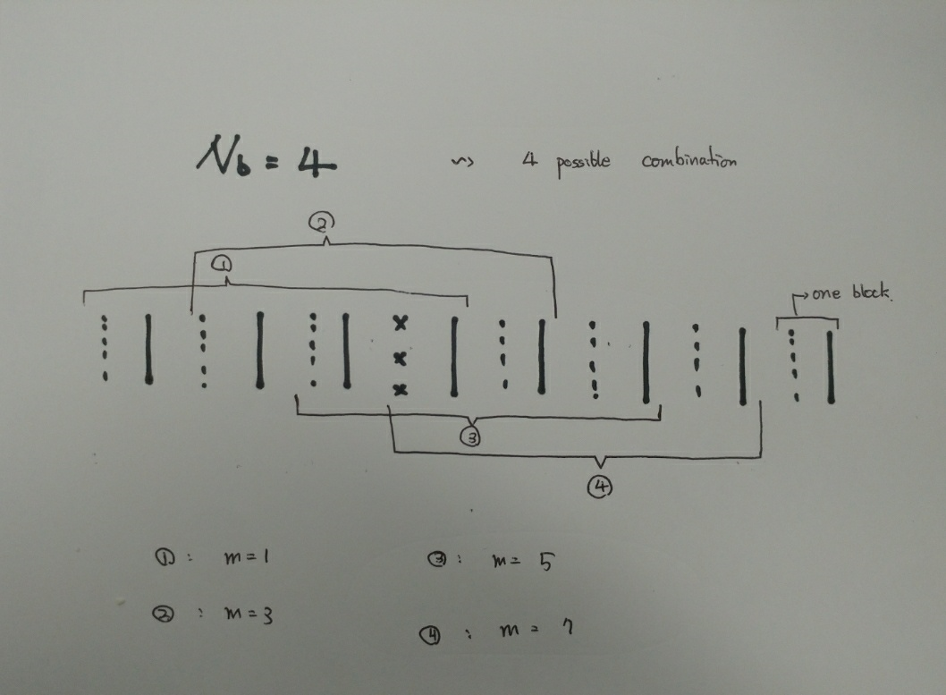
GRAPPA
- Image reconstruction (sliding block approach)

Slide 9
GRAPPA
- Features
Magnitude reconstruction
-> No phase cancellation problems
Sum of square
-> Alleviate SNR problems

Slide 10
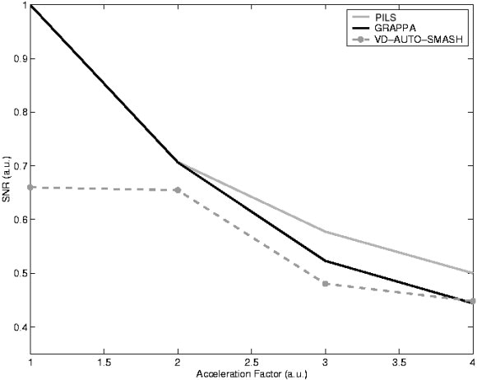
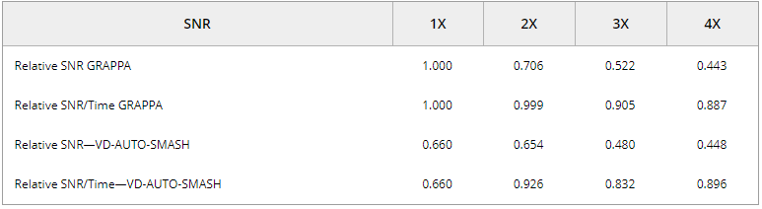
Result

Slide 11
Discussion
Using adaptive array combination instead of sum of square
If we got the highly accurate coil sensitivity map, SENSE is better
Can get a better optimized result with more number of channels.

Slide 12
Conclusion
An extended blockwise VD-AUTO-SMAHS reconstruction
Good quality of image
Particularly useable in areas where coil sensitivity maps are hard to obtain

